Slide 1
Personal Automobile Insurance More Accidents, Larger Claims Drive Costs Higher
October 2016
Insurance Information Institute  110 William Street  New York, NY 10038 212.346.5500  info@iii.org  www.iii.org

Slide 2
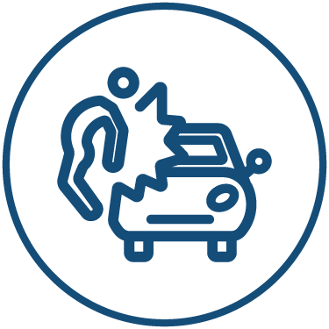
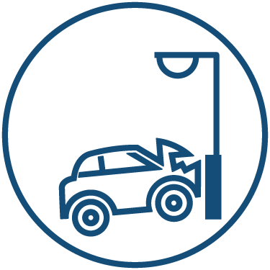
The Big Problem: Insurance Costs Are Rising
Auto Insurance Increase in Loss Costs, 2014:Q1–2016:Q1
Bodily Injury
9.6%
Property
Damage
14.7%
Personal Injury Protection
18.4%
Collision
11.1%
Comprehensive
11.0%
From early 2014 to early 2016, the cost of accidents has risen dramatically. By contrast, consumer prices overall rose 1.7 percent during 2014 and 2015.
Source: Fast Track Monitoring System.
Notes:
The amount of claim costs per vehicle insured - known as loss costs in the industry - is the primary cost in auto insurance rates. Those have been rising across all major coverages.

Slide 3
More Accidents
Collision Claims: Frequency Trending Higher in 2015
The accident rate – the number of claims per hundred vehicles – is rising.
Source: Fast Track Monitoring System, Insurance Information Institute.

Slide 4
Why More Accidents? More Driving
More Miles Driven, More Collisions, 2006–2015
Billions of Miles Driven in Prior Year
Overall Collision Claims per 100 Insured Vehicle Years
People are driving more. The more miles people drive, the more likely they are to get in an accident.
Source: Federal Highway Administration, Rolling Four-Qtr Avg. Frequency from Fast Track Monitoring System, Insurance Institute for Highway Safety, Insurance Information Institute.

Slide 5
Why More Accidents? More Jobs
More People Working and Driving => More Collisions, 2006–2016
Number Employed, Millions
Overall Collision Claims per 100 Insured Vehicle Years
People are driving more because the economy is improving.
Source: Seasonally adjusted employed from Bureau of Labor Statistics, rolling four-quarter average frequency from Fast Track Monitoring System, Insurance Information Institute.

Slide 6
Accidents Are Getting More Expensive
Collision Claims: Severity Trending Higher in 2009–2015
The average claim size has risen steadily since 2010.
Source: Fast Track Monitoring System, Insurance Information Institute.

Slide 7
Why Are Accidents More Expensive? Repair Costs
Cost of Body Work Is Rising Faster Than Costs Overall
The cost of repairing autos is rising faster than overall inflation.
Indexed so 2004 = 100.
Source: Insurance Information Institute, Bureau of Labor Statistics.

Slide 8
Severity: Driving Fatalities Are Rising
On Track for 18% Increase in Two Years
Annual Change in Motor Vehicle Deaths
Seatbelt Use Rose to 62% of Drivers, From 49% in ‘90
Big Drop-off Due to the Great Recession
Driving has been getting safer for decades, but recent trend is discouraging—38,300 deaths in 2015.
Source: National Safety Council, Insurance Information Institute.

